Slide 1
SQL Injection
own the database

Slide 2

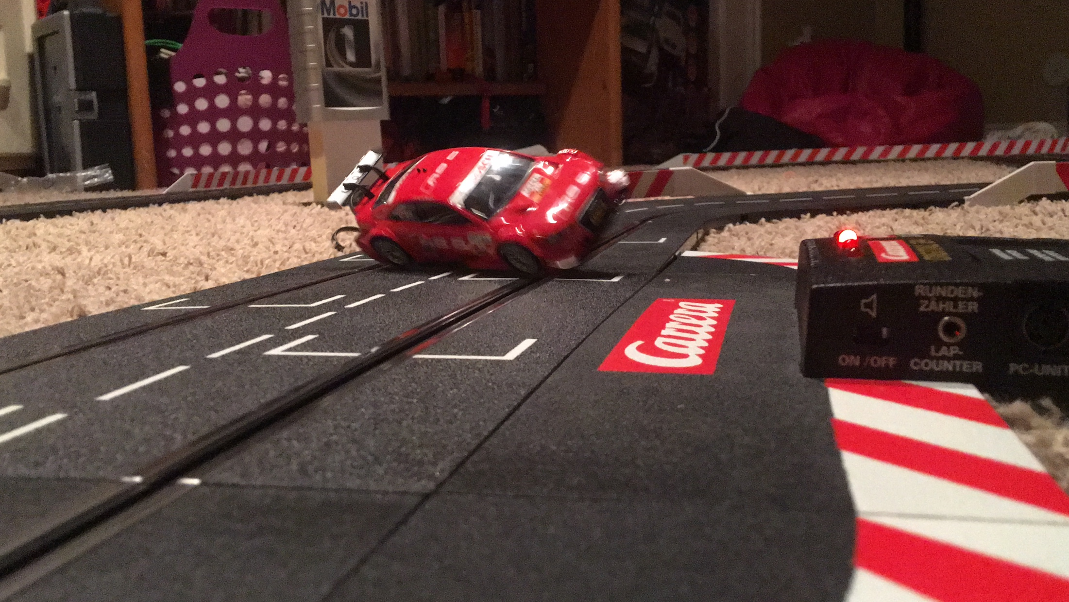
About Me
Name: Davis
IRC/Twitter: @gr3yR0n1n
Hobbies: Hardware Hacking, Security Research, Mountain Biking, Hiking, and recently slot car racing w/ my son

Slide 3

WARNING: Do Not Hack Your Friends!

Slide 4
OWASP Top 10 [2013]
A1: Injection
A2: Broken Authentication and Session Management
A3: Cross-Site Scripting (XSS)
A4: Insecure Direct Object References
A5: Security Misconfiguration
A6: Sensitive Data Exposure
A7: Missing Function Level Access Control
A8: Cross-Site Request Forgery (CSRF)
A9: Using Components with Known Vulnerbilities
A10: Unvalidated Redirects and Forwards

Slide 5

What is SQL Injection?
A technique of injecting SQL code into the executing SQL statement. This can happen when input is not properly sanitized.

Slide 6
3 Types of SQL Injection
Inband: Data extracted from the expected result set.
Out-of-Band: Data extracted through a result of the sql statement other than the expected result set. (e.g. an email is sent as a result of the injected sql being executed.
Inferential: No actual data transferred. Schema and information inferred.

Slide 7
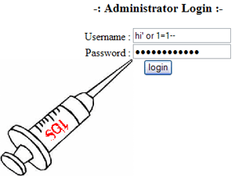
Time to Inject Some SQL

Slide 8

Time to Inject Some SQL
Note to self, time to inject means:
Switch to the VM and demonstrate ;)

Slide 9
Preventive Measures
Vaildate/Escape All User Input
Whitelisting
Blacklisting
Parameterized Statements
Stored Procedures
Encode Output

Slide 10
Validate/Escape All User Input
Whitelisting
Use explicit code and/or regular expressions to only permit input that is allowed.
Blacklisting
Use explicit code and/or regular expressions to block any input that is NOT allowed.

Slide 11
Parameterized Statements
No:
username = request("username")
uassword = request("password")
sql = "SELECT * FROM users WHERE username='" + username + "' AND password='"+ password + "'"
result = db.Execute(Sql)
Yes:
sql = "SELECT * FROM users WHERE username=@username AND password=@password";
cmd = new SqlCommand(sql, conn);
cmd.CommandType = CommandType.Text;
cmd.Parameters.Add(new SqlParameter("@username", username));
cmd.Parameters.Add(new SqlParameter("@password", password));
reader = cmd.ExecuteReader();

Slide 12
Stored Procedure
YES:
cmd = new SqlCommand("sp_AuthenticateUser", conn);
cmd.CommandType = CommandType.StoredProcedure;
cmd.Parameters.Add(new SqlParameter("@username", username));
cmd.Parameters.Add(new SqlParameter("@password", password));
reader = cmd.ExecuteReader();

Slide 13
Encode Output
Helps to protect against data inserted into the database from 3rd party and other untrusted sources.
This helps to protect against XSS
This also helps to ensure that sql injection is not taking place when executing sql statements based on assumed trusted data in the database.
Note: Stored Procedures & Parameterized Queries will also help with this.

Slide 14

Summary
Understand where data is coming from
Look for vulnerable areas where SQLi could be an issue
Sanitize untrusted input

Slide 15
References
SQL Injection Attacks and Defense
http://www.syngress.com/hacking-and-penetration-testing/SQL-Injection-Attacks-and-Defense/
OWASP
A1 (SQLi): https://www.owasp.org/index.php/Top_10_2010-A1
Pentest Monkey
Overview: http://pentestmonkey.net/category/cheat-sheet/sql-injection
MySQL: http://pentestmonkey.net/cheat-sheet/sql-injection/mysql-sql-injection-cheat-sheet
By Example:
http://www.unixwiz.net/techtips/sql-injection.html
Live Sites:
OWASP:
https://www.hacking-lab.com/Remote_Sec_Lab/free-owasp-top10-lab.html
DVWA
PHP/MySQL: http://www.dvwa.co.uk
AltoroMutual
ASP.NET: http://www.altoromutual.com

Slide 16

Thank you
Questions?

